Slide 1
Add Ruby support to Intellij Idea From the Settings > Plugins
Install RubyInstaller for Windows
Update gems to latest version from command line
Install the gems that you would use in your code, for rails install rails with gem
Now follow the rest of the slides
An .iml file gets created by Intellij Idea in the project which means now its ready for all the gems to show Intellisense.

Slide 2
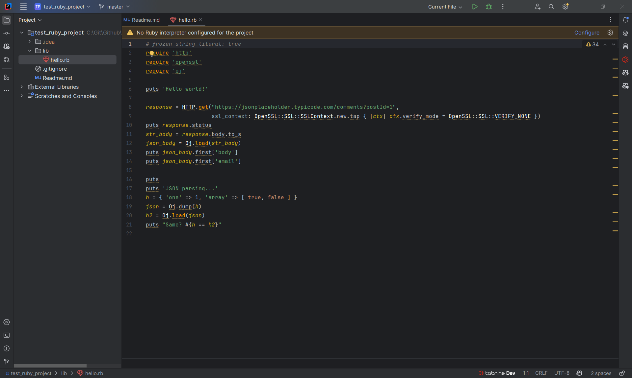

Slide 3
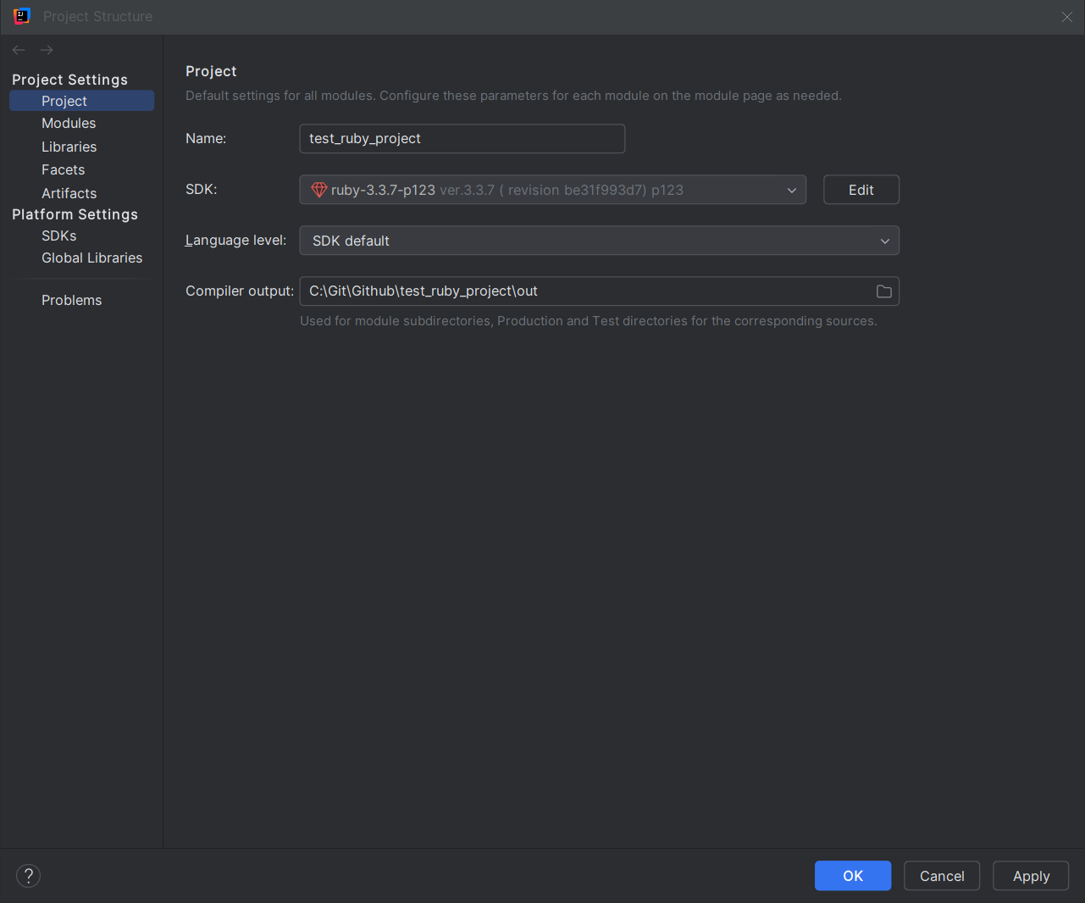

Slide 4
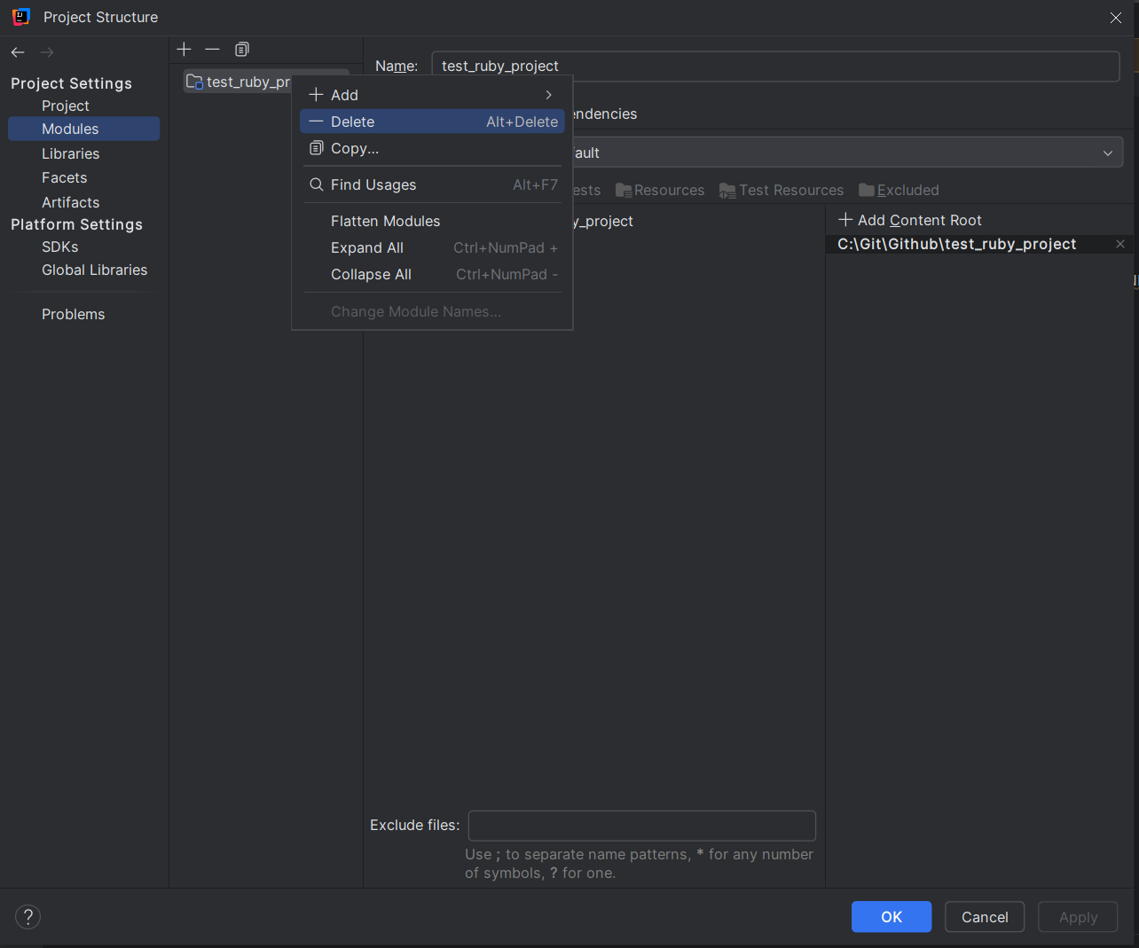

Slide 5
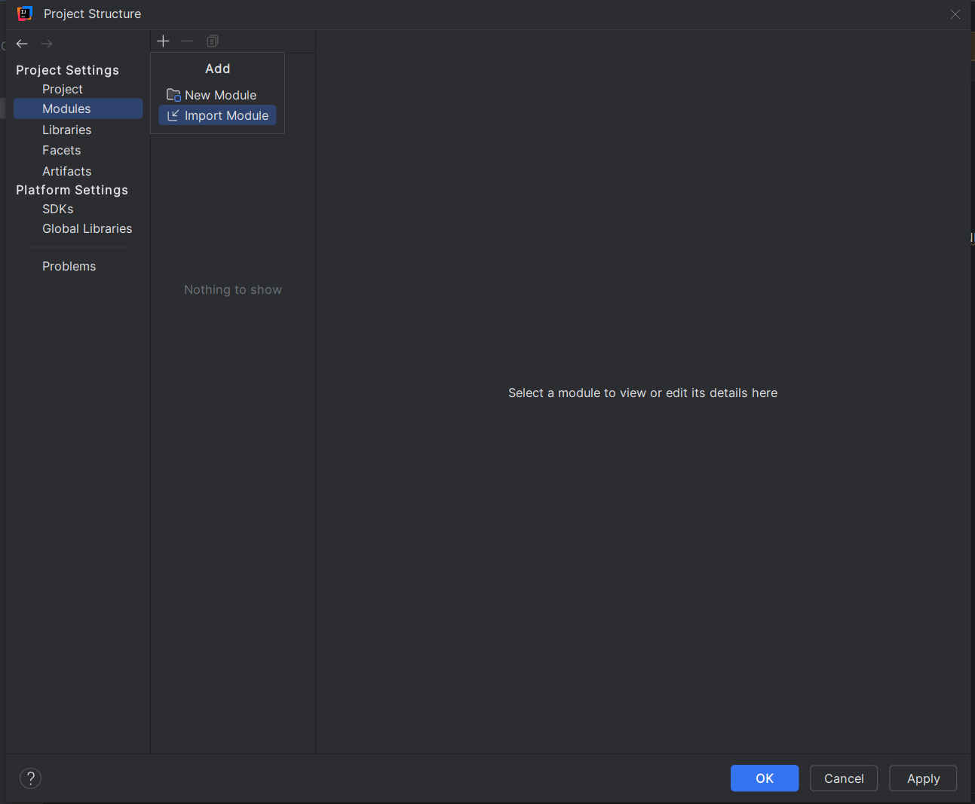

Slide 6
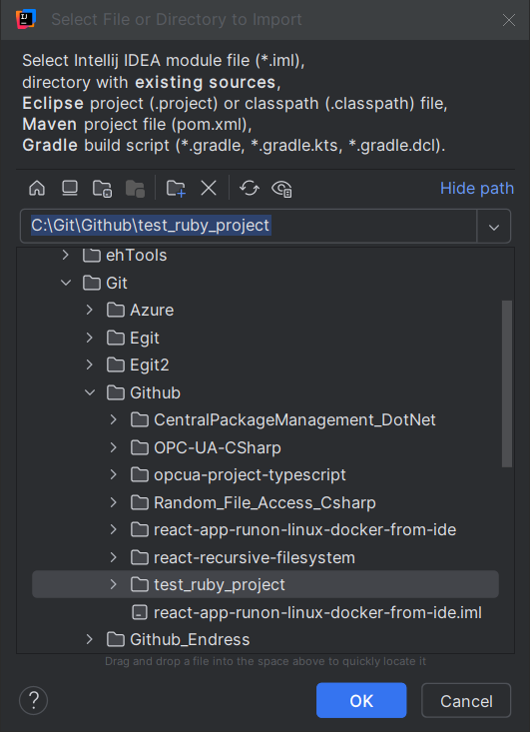

Slide 7
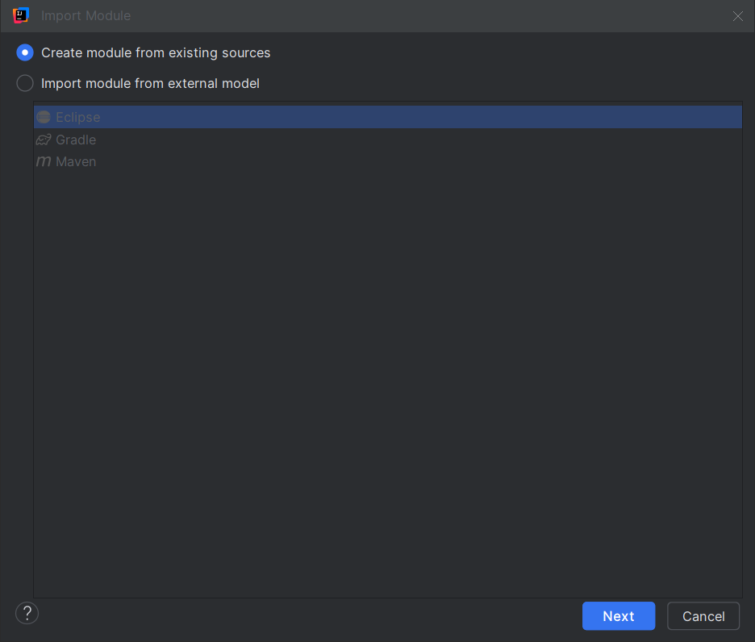

Slide 8
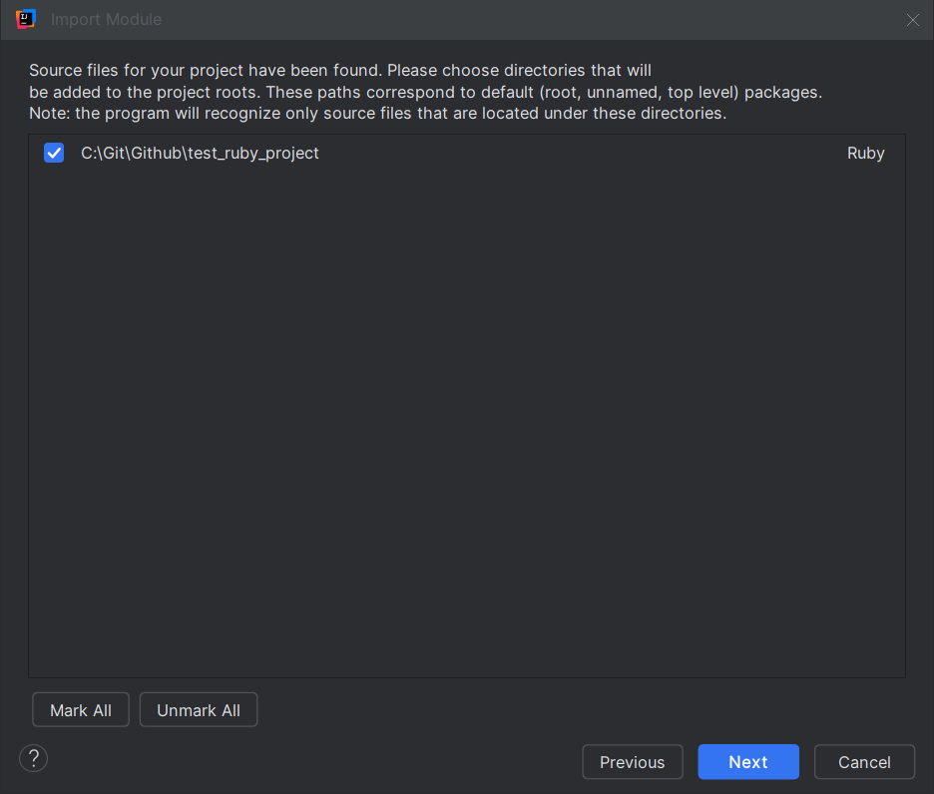

Slide 9
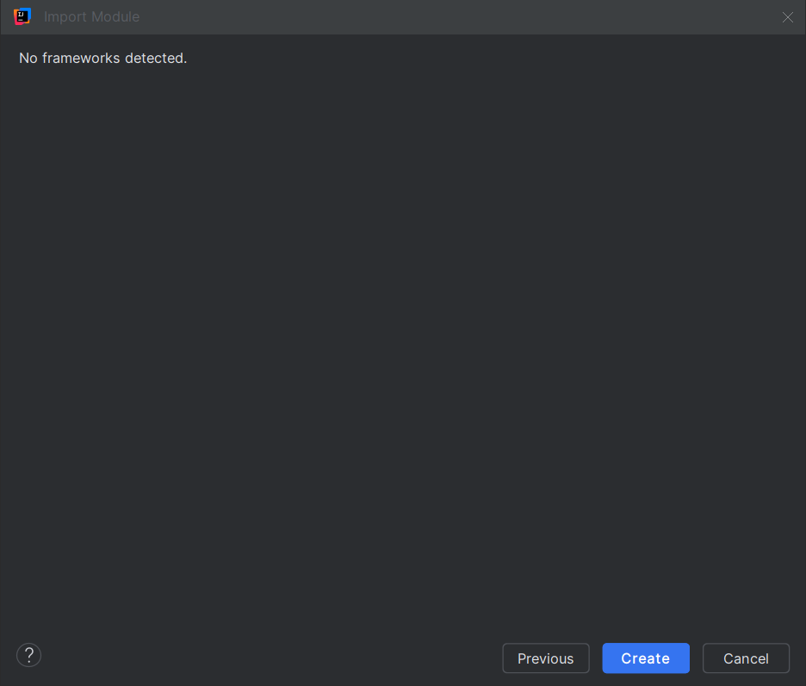

Slide 10
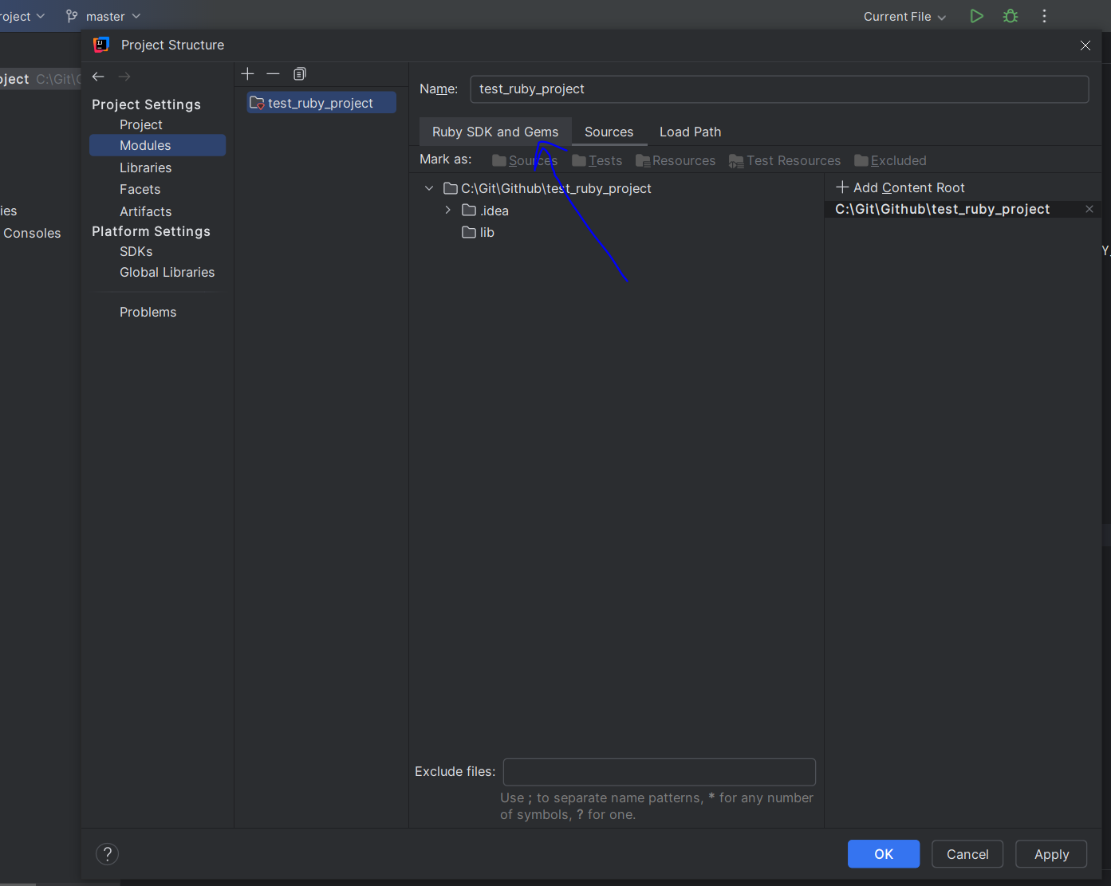

Slide 11
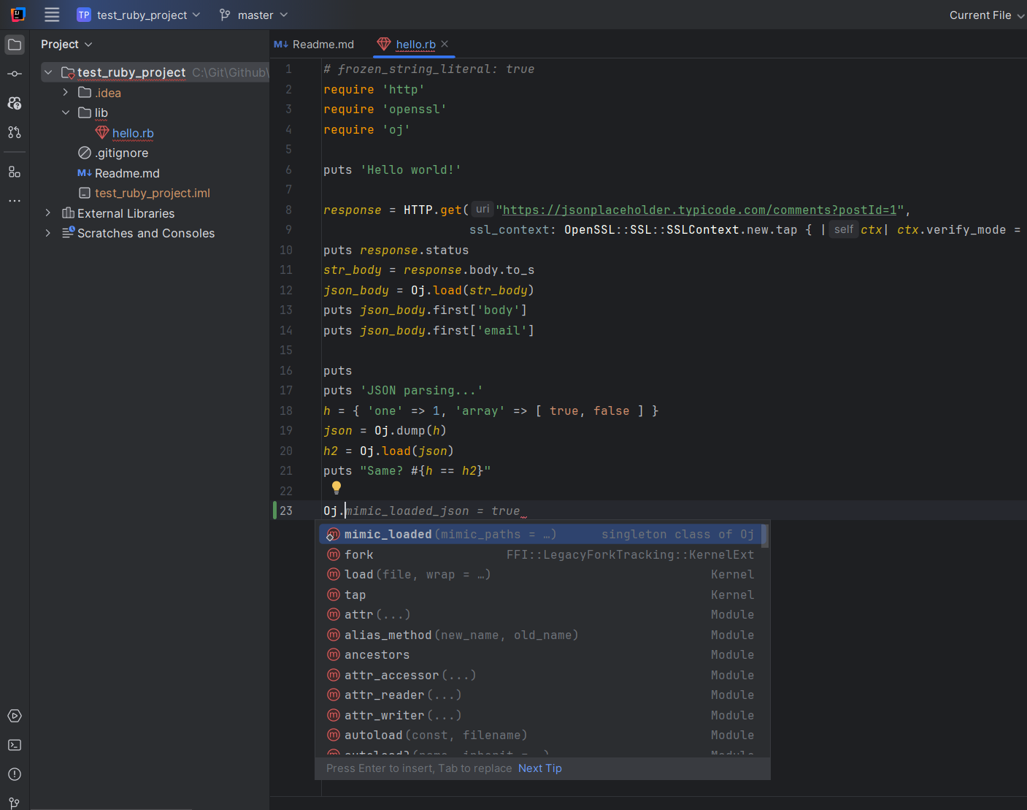
Notes:
Intellisense works now

